Slide 1
DAA_Assignment 2 (Day 2)
Yash NC
181210062

Slide 2
Minimum Spanning Tree
(MST)
MST a spanning tree whose sum of edge weights is as small as possible. More generally, any edge-weighted undirected graph has a minimum spanning forest, which is a union of the minimum spanning trees for its connected components.

Slide 3
Minimum Spanning Tree
Time Complexity :
Kruskal's algorithm can be shown to run in O(E log E) time, or equivalently, O(E log V) time, where E is the number of edges in the graph and V is the number of vertices

Slide 4
General Properties of Minimum Spanning Tree
1)Connected graph G can have more than one spanning tree.
2)All possible spanning trees of graph G, have the same number of edges and vertices.
3)The spanning tree does not have any cycle (loops).
4)Removing one edge from the spanning tree will make the graph disconnected, i.e. the spanning tree is minimally connected.
5)Adding one edge to the spanning tree will create a circuit or loop/

Slide 5
Applications of Minimum Spanning Tree
Time Complexity :
Kruskal's algorithm can be shown to run in O(E log E) time, or equivalently, O(E log V) time, where E is the number of edges in the graph and V is the number of vertices

Slide 6
Algorithm’s to find MST
There are two algorithm’s to find Minimum Spanning Tree :
1) Prim’s Algorithm
2) Kruskal’s Algorithm

Slide 7
Minimum Spanning Tree
(MST)
(Applications)
Civil Network Planning
Computer Network Routing Protocol
Cluster Analysis

Slide 8
Kruskal's Algorithm
It is a greedy algorithm in graph theory as it finds a minimum spanning tree for a connected weighted graph adding increasing cost arcs at each step.

Slide 9
Kruskal's Algorithm
Kruskal's Algorithm is used to find the minimum spanning tree for a connected weighted graph. The main target of the algorithm is to find the subset of edges by using which, we can traverse every vertex of the graph. Kruskal's algorithm follows greedy approach which finds an optimum solution at every stage instead of focusing on a global optimum.

Slide 10
Kruskal's Algorithm
Time Complexity :
Kruskal's algorithm can be shown to run in O(E log E) time, or equivalently, O(E log V) time, where E is the number of edges in the graph and V is the number of vertices

Slide 11
Kruskal's Algorithm (Algo.)
Step 1: Create a forest in such a way that each graph is a separate tree.
Step 2: Create a priority queue Q that contains all the edges of the graph.
Step 3: Repeat Steps 4 and 5 while Q is NOT EMPTY
Step 4: Remove an edge from Q
Step 5: IF the edge obtained in Step 4 connects two different trees, then Add it to the forest (for combining two trees into one tree). ELSE Discard the edge
Step 6: END

Slide 12
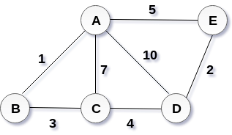
Kruskal's Algorithm (Example)
Start constructing the tree :
Add AB to the MST
Add DE to the MST
Add BC to the MST
The next step is to add AE, but we can't add that as it will cause a cycle.
The next edge to be added is AC, but it can't be added as it will cause a cycle
.
The next edge to be added is AD, but it can't be added as it will contain a cycle.
Hence, the final MST is the one which is shown in the step 4. the cost of MST = 1 + 2 + 3 + 4 = 10.

Slide 13
Prim’s Algorithm
To find a spanning tree whose sum of edge weights is as small as possible for a weighted undirected graph

Slide 14
Prim’s Minimum Spanning Tree
Prim’s algorithm is a Greedy Approach.
The algorithm operates by building this tree one vertex at a time, from an arbitrary starting vertex, at each step adding the cheapest possible connection from the tree to another vertex.
The time complexity of Prim's algorithm depends on the data structures used for the graph and for ordering the edges by weight.
O(N^2) - Adjacency matrix (what we will be using in this problem)

Slide 15
Idea Behind Prim’s Algorithm
The idea behind Prim’s algorithm is simple, a spanning tree means all vertices must be connected. So the two disjoint subsets of vertices must be connected to make a Spanning Tree. And they must be connected with the minimum weight edge to make it a Minimum Spanning Tree.Two sets of vertices are maintained. The first set contains the vertices already included in the MST, the other set contains the vertices not yet included. At every step, it considers all the edges that connect the two sets, and picks the minimum weight edge from these edges. After picking the edge, it moves the other endpoint of the edge to the set containing MST.

Slide 16
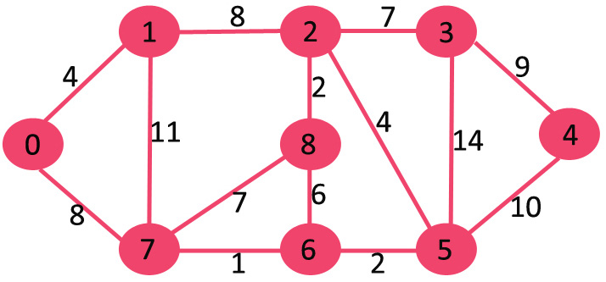
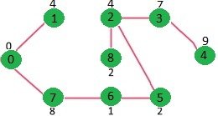
Idea of solving problems using Prim’s Algo.
Given weighted Undirected Graph
Minimum Spanning Tree of the Graph ( Prim’s Algorithm )

Slide 17
Prim’s Algorithm (Algo.)
Step 1: Select a starting vertex
Step 2: Repeat Steps 3 and 4 until there are fringe vertices
Step 3: Select an edge e connecting the tree vertex and fringe vertex that has minimum weight
Step 4: Add the selected edge and the vertex to the minimum spanning tree T
Step 5: EXIT

